Slide 1

Proposed Strategy – Performance Improvement and Quality Assurance
Harry Rice

Slide 2
Background
Related Education & Experience
Career Roadmap

Slide 3
Background: Related Education & Experience
Veteran of the US Navy Nuclear Submarine Service: Qualified as Operator & Supervisor on (7) NPPs; Prototype Instructor; Advanced Engineering School Development Specialist
DOE: Inventor of the Computerized Training Management System (CTMS); Winner of the DOE TRADE Award for Excellence
Commercial Nuclear Power Plant (NPP): Developer of Technical Training Programs for INPO Accreditation
Small Business Executive, Development Specialist: 8(a), Minority-Owned Business, GSA Contracts
DOE: Nuclear Waste Treatment Plants; Developer of Technical Training Programs, QMS Toolsets
Robotics: Automotive Manufacture; Autonomous Vehicles: Model QMS/SMS/LMS builder
New Nuclear Power Plants: Implemented the technical training resources to bring Shoreham NPS to Low-Power Testing; Provided Inspection, Test, Analysis, and Acceptance Criteria to bring Vogtle Units #3 & 4 to Readiness for NRC Evaluation
DOE Research Facilities: BNL – HFBR (like the HFIR) Implemented the technical training for roles operate, maintain, and experiment
Innovation and Invention: Rural communities emergency response capability enhancements, eHealth initiatives
Performance Assurance: Cross-functional process improvement team builder and leader, enabling intranet for dashboarding and reporting
Quality: Quality Management Systems leadership for the selection, tailoring, development, implementation, and evaluation to satisfy the highest regulatory, corporate, and customer (contracts) requirements across all functional areas

Slide 4
CAREER ROADMAP
A Hybrid – Working on Both Sides of the Invoice
MILESTONE
MILESTONE
MILESTONE
MILESTONE
Youngest Navy Nuclear Operator
SNPS NPP Supervisor, BS Equivalency
VP, IT Business Dev. $2M-to – $7M
200+ DCS built, installed, tested, 1st NRC SER
MILESTONE
MILESTONE
MILESTONE
MILESTONE
Youngest CPO (E-7) SDRO, EWS
I&C & Electrical Technical Training Program INPO Accreditation
Licensed Professional Consultant
AP1000 EPC ITAAC/QMS
MILESTONE
MILESTONE
MILESTONE
MILESTONE
CAREER
START
First SAT method in Advanced Eng. Schools
CTMS –
DOE TRADE Award & Patent
CMMS, ISMS, and QMS for DOE/DOD Systems
T1 - ISO 9001 QMS Recert.,
SCADA,
AM OEM - QMS/SMS/LMS Model
DEC
1974
1980
1982
1988
1993
1995
2000
2008
2010
2013
2017
2022
Next:
RMS/QMS/SMS/LMS “SYSTEM OF SYSTEMS” MODEL EXERCISED
USN (SS)
NPP/
DOE
SBA
DOE/ OEM/ NPP
Information Technology, Safety, Health Science, Finance & Insurance
Military Career Goal
(got 12 years into)
New Reactor Build /
Experimental Reactor
WM Facilities,
DCS Design/Mfg.,
NPP EPC

Slide 5
Vision for the Management System
Cross-functional process improvement team participation
Mapping the processes
Seamless/streamlined workflows with toolsets for contract assurance metrics and trend analyses
Common Platform across Management System Owners on the intranet

Slide 6
Vision for the Management System
CFPIT participation
Mapping processes
Workflows with toolsets
Common Platform
Perform gap analysis on the implementation of Orders, Directives, Regulations, and adopted Standards
Recruit Process Owner and SME role owners for all functions
Develop a cross-organization PAQ maintenance / improvement plan with a roster and schedule
Charter Boards/ Committees
Carry the QAP through to the requirements of the contracts
Define and document processes
Determine interfaces and protocols used to cross swimlanes in each process and externally
Establish OKRs, KPIs to assess effectiveness and efficiency
Management system owners self-assess for linking functions cross-organizationally with a toolset
DCRMs assessed for centralized “Source of Truth” tool
Dashboarding tool for OKRs and KPIs
Reporting tool
Self-assessment/ Management Assessment tool
Assessment scheduling and documenting tool
Trending analysis shared on results, evidencing continual improvement
Single escalation path for issues management through to any corrective/ preventive action
Impact assessment accommodation cross-functionally

Slide 7

Thank you
Harry Rice
Principal Consultant
harry@picsllc.net
412-525-2847

Slide 8
Backup slides:
Requirements, Quality, Safety, Learning Management (RMS/QMS/SMS/LMS) “System of Systems” Model
Mapping the QAP to the Contract(s)
QMS CAPA process workflow
Model for Improvement Methods
  Process Decision Program Chart (PDPC)
  Interrelationship Diagraph or Diagram (ID)

Slide 9
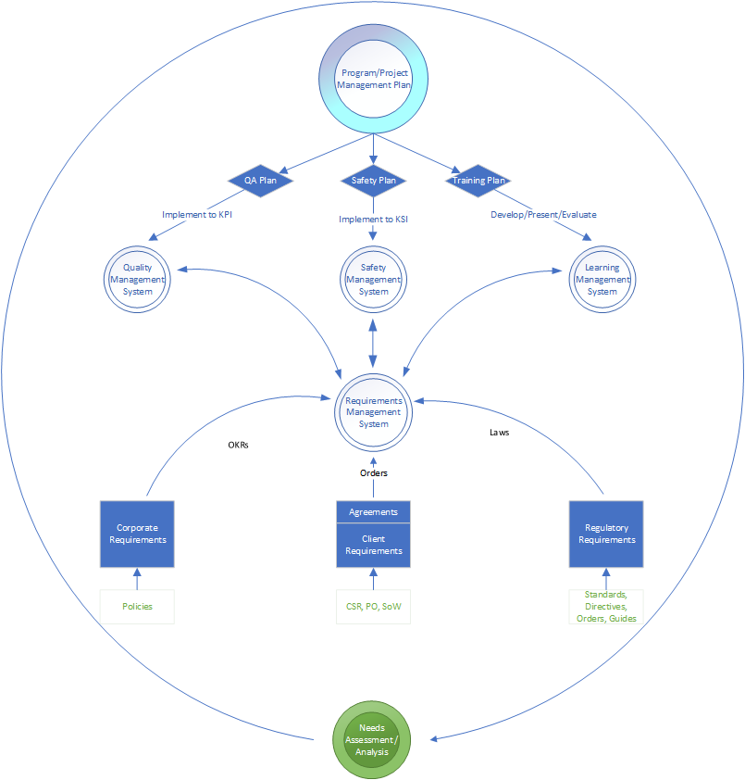
REQUIREMENTS, QUALITY, SAFETY, LEARNING MANAGEMENT SYSTEM OF SYSTEMS MODEL
Whitepaper

Slide 10
Mapping QAPD to Contract

Slide 11
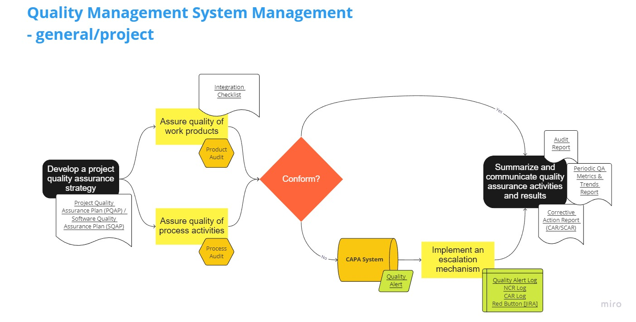

Slide 12
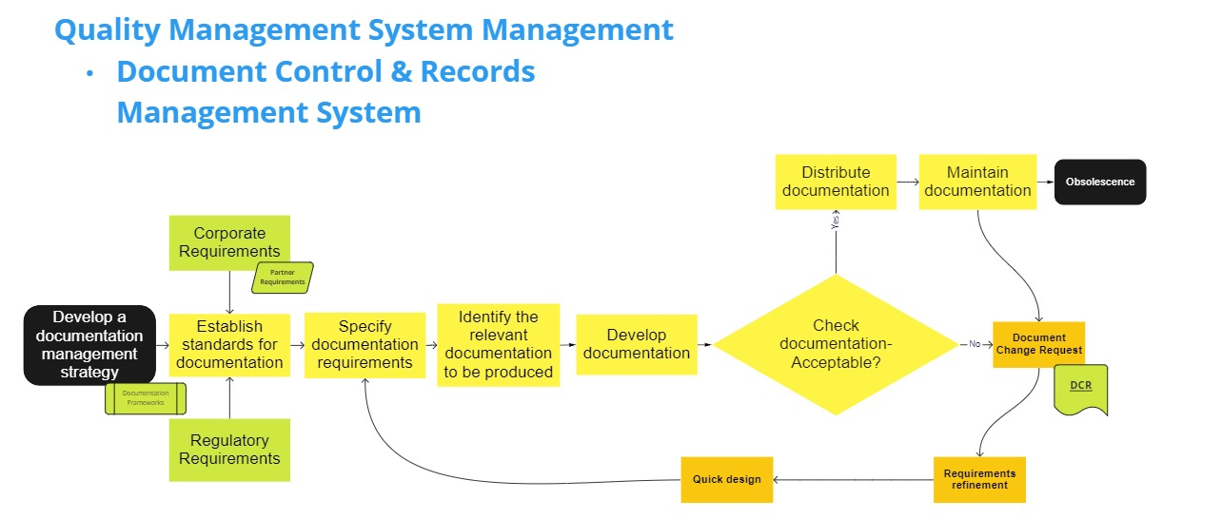

Slide 13
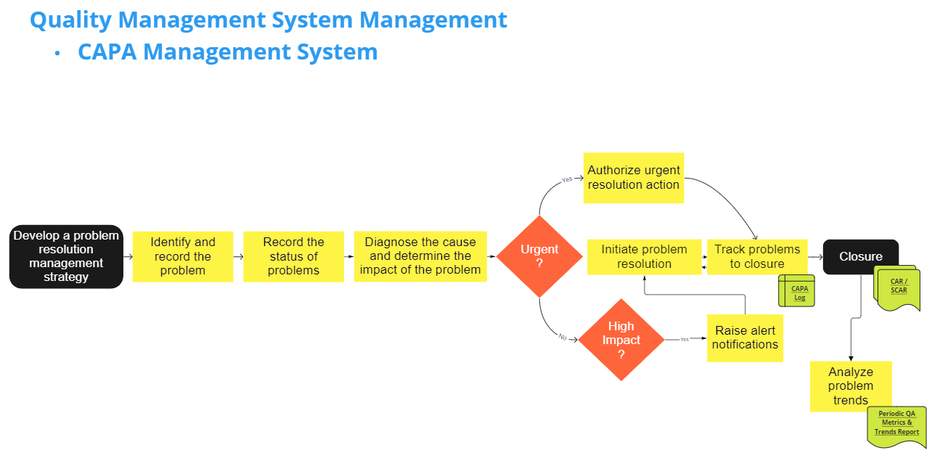

Slide 14
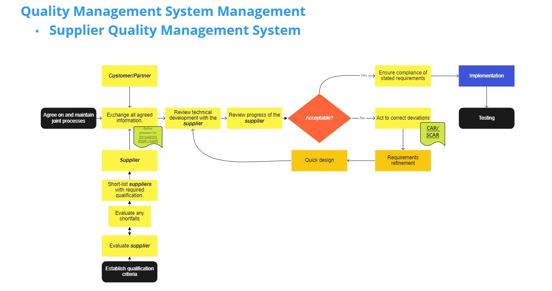

Slide 15
Model for Improvement Processes - PDPC

Slide 16
Model for Improvement Processes - ID

Slide 17
